Slide 1
Journey PPT
Bootcamp Week 2
Omeir Fawaz
Associate Data Engineer

Slide 2

Agenda
01
Agile Methodology, Azure DevOps
02
DBMS
03
Testing
04
DevOps – CI/CD
05
Azure VM and GitHub Actions
Copyright of Shell International B.V.

Slide 3










Safety and Health On Site
On the Move
Ensure confidential discussions are not overheard
Have an emergency and evacuation plan in place
Do not take this call, or any other call, while driving – ever
Make sure your workspace is ergonomically sound
Ensure understanding of fire safety
Do not use any hands-free device – Bluetooth, built-in, etc. – whilst driving
Know what the fire alarm sounds like
Make sure that you can hear the fire alarm
Make sure your smoke alarms work
Maintain clear walkways and fire exits
Ensure adequate lighting in the room when you work
Continue to follow COVID guidelines
In the event of any kind of emergency, please leave the call – promptly and safely
Clean surfaces frequently

Slide 4
2.1
Agile Methodology, Azure DevOps

Slide 5
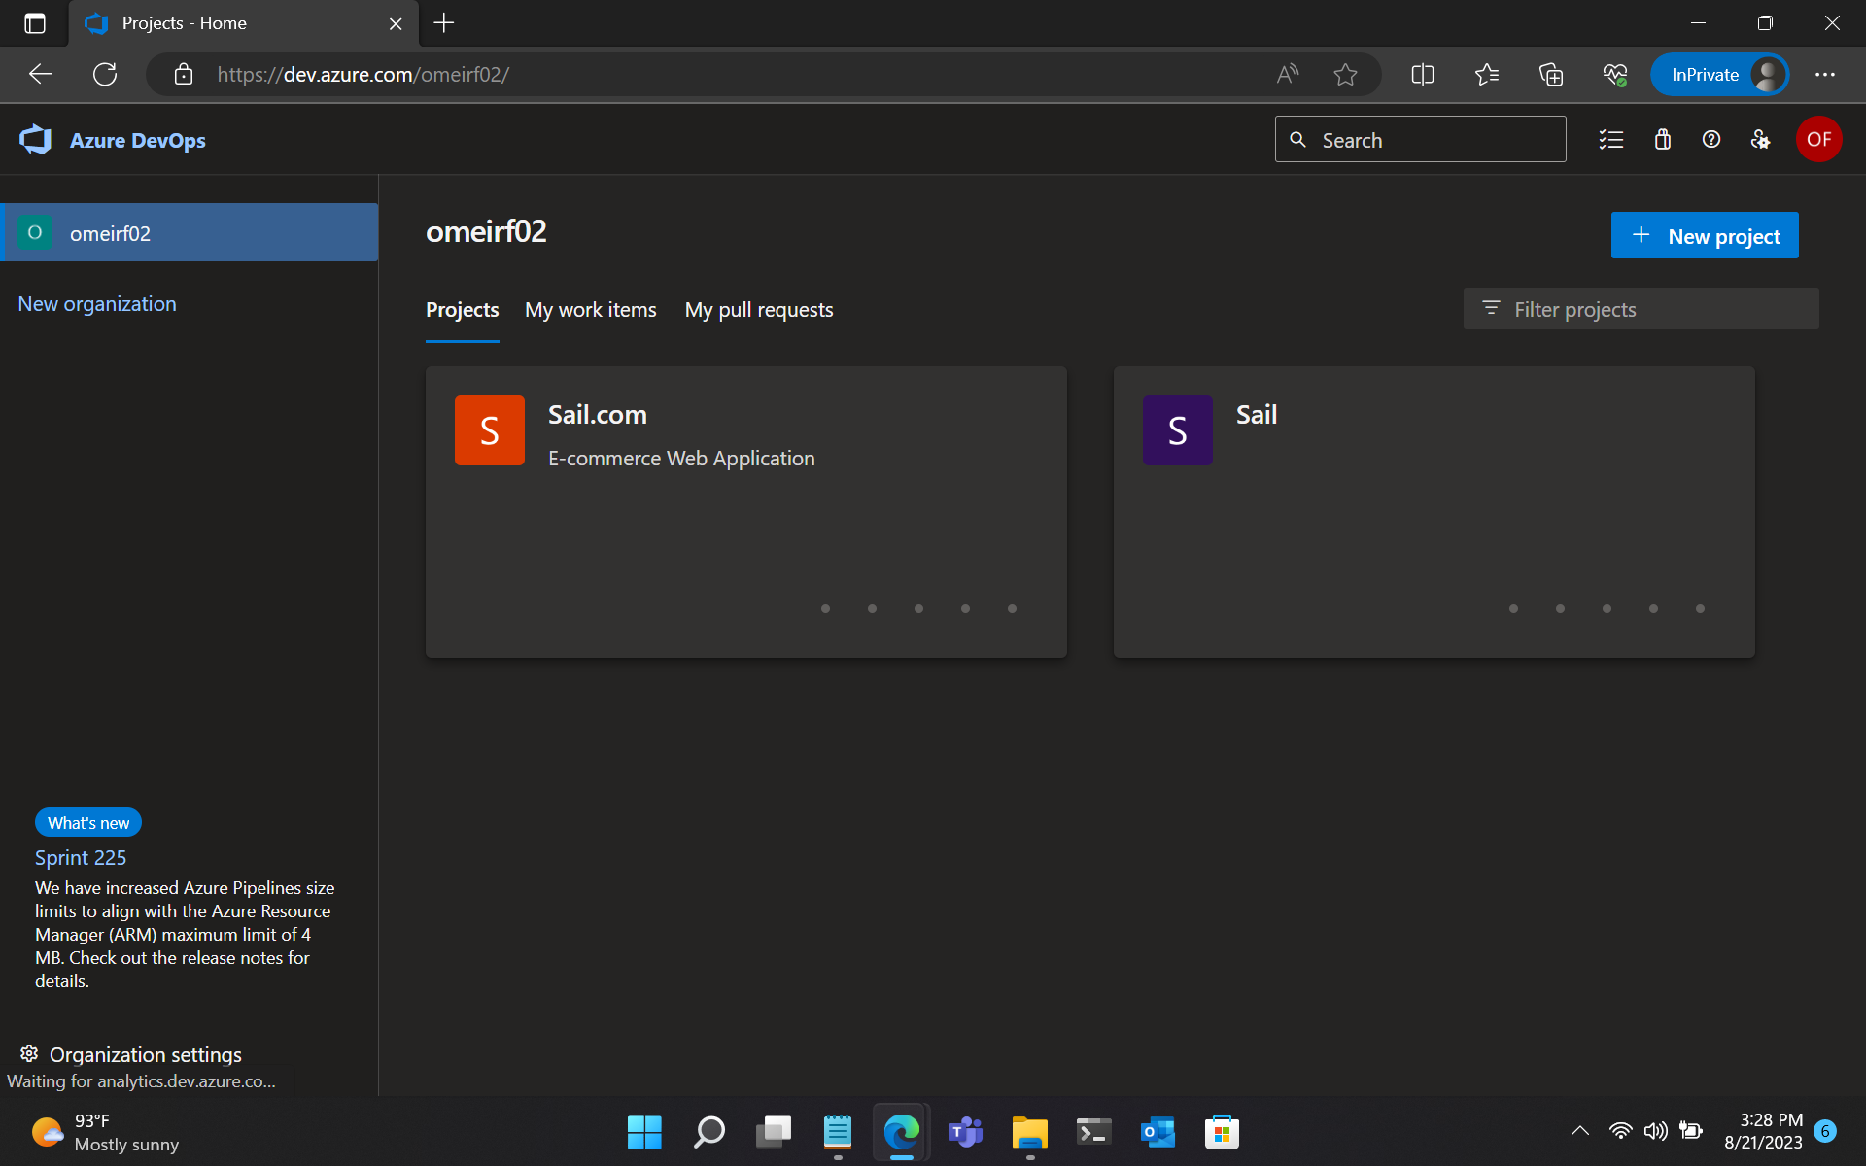
1. Creating an Organisation in Azure DevOps

Slide 6
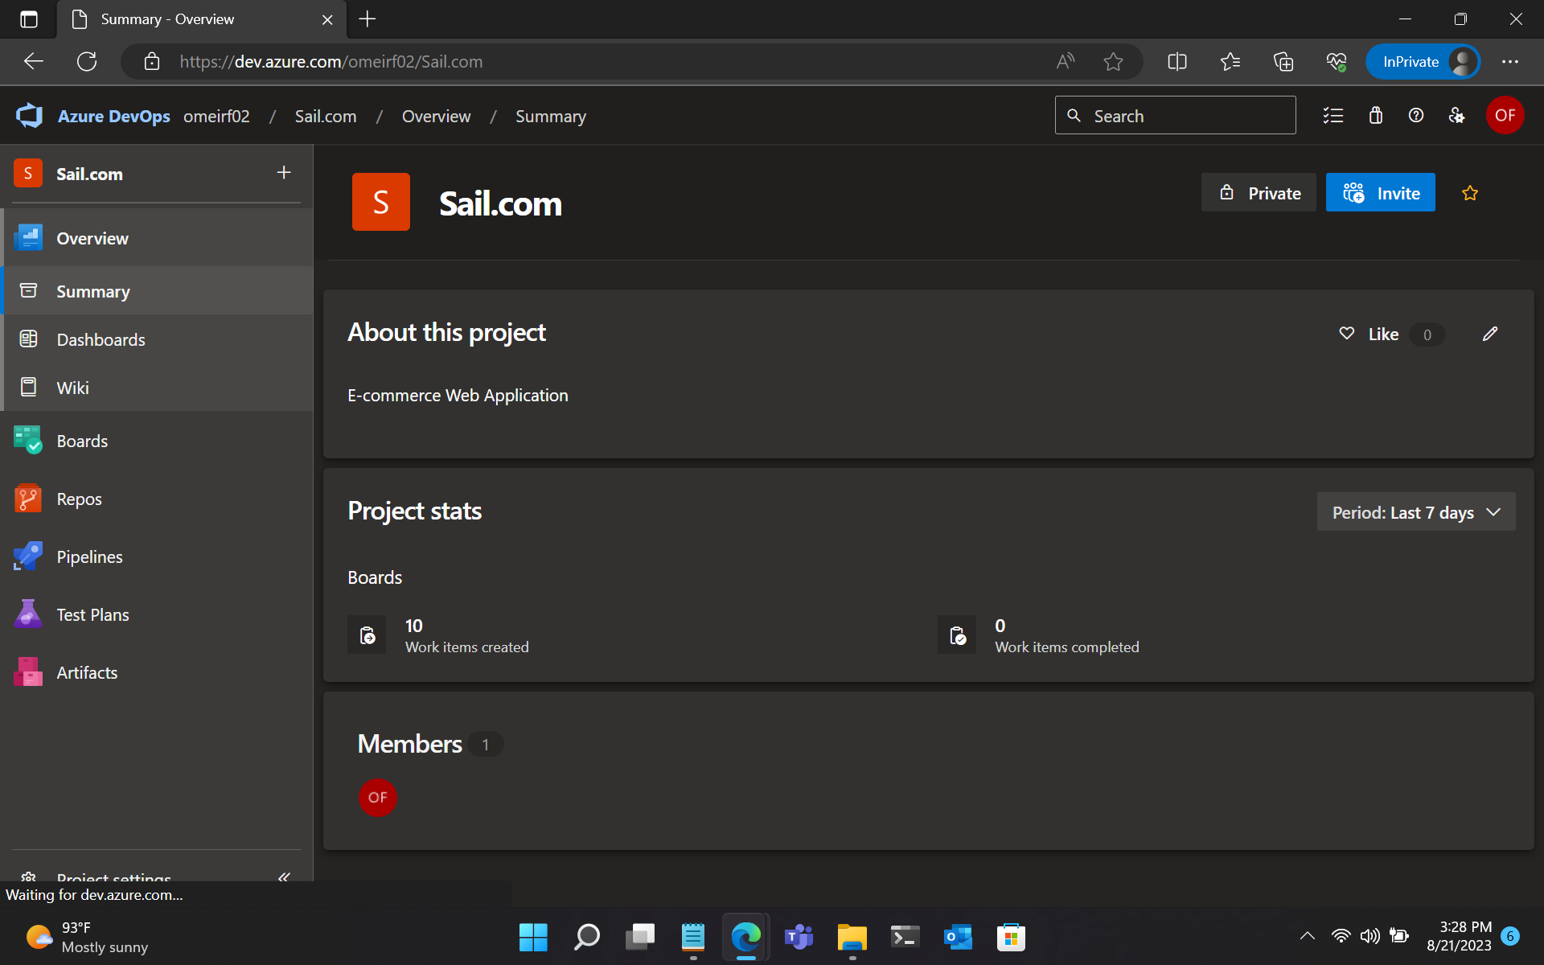
2. Creating a Project in Azure DevOps

Slide 7
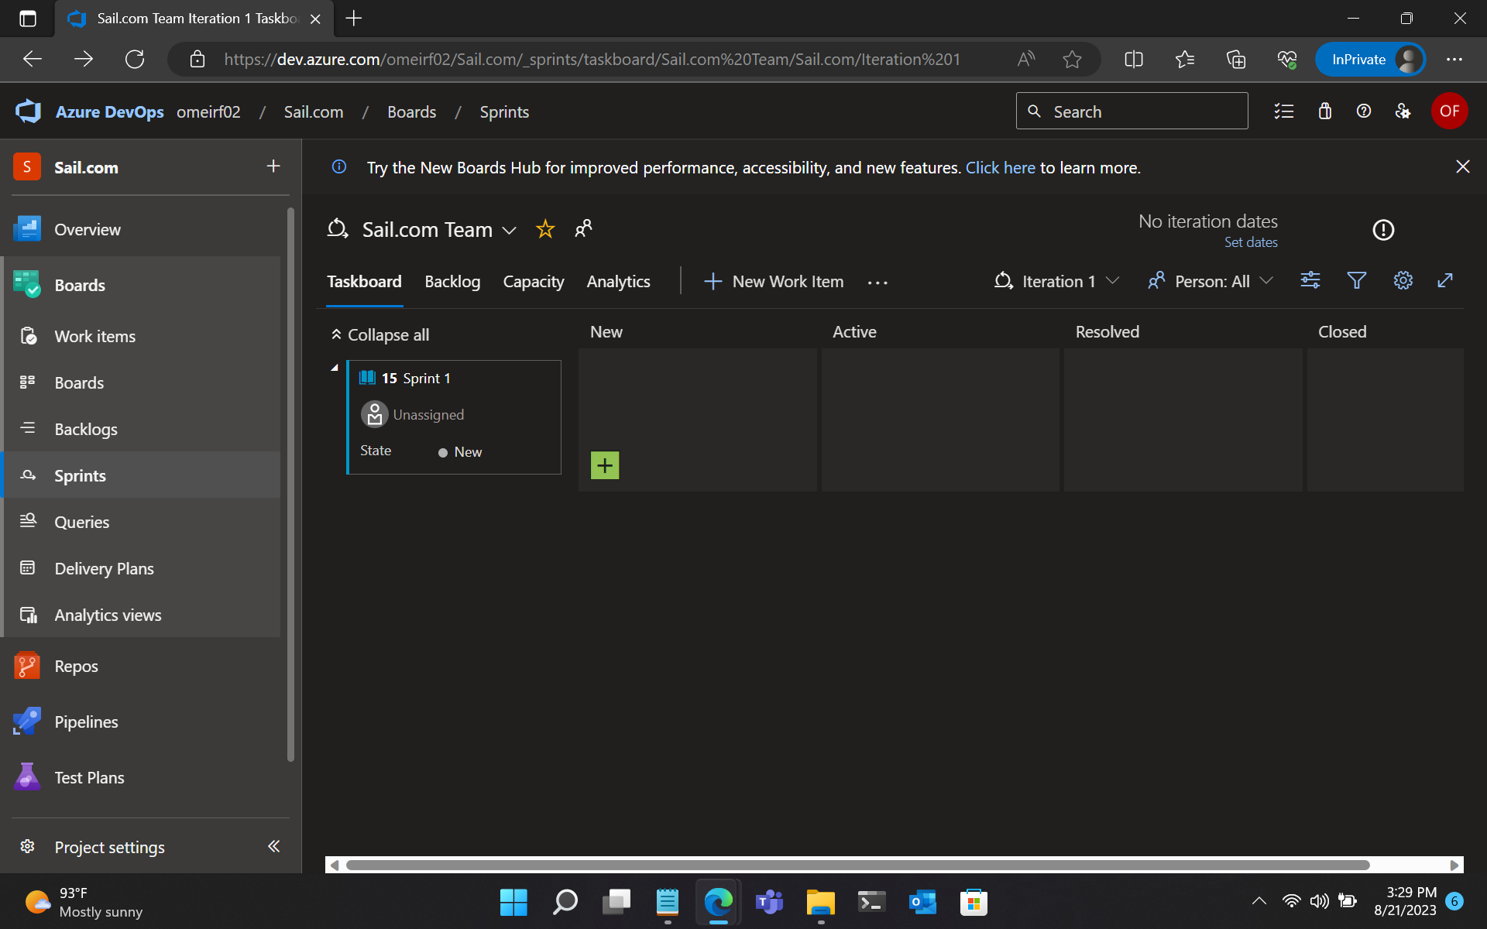
3. Creating a Sprint in Azure DevOps

Slide 8
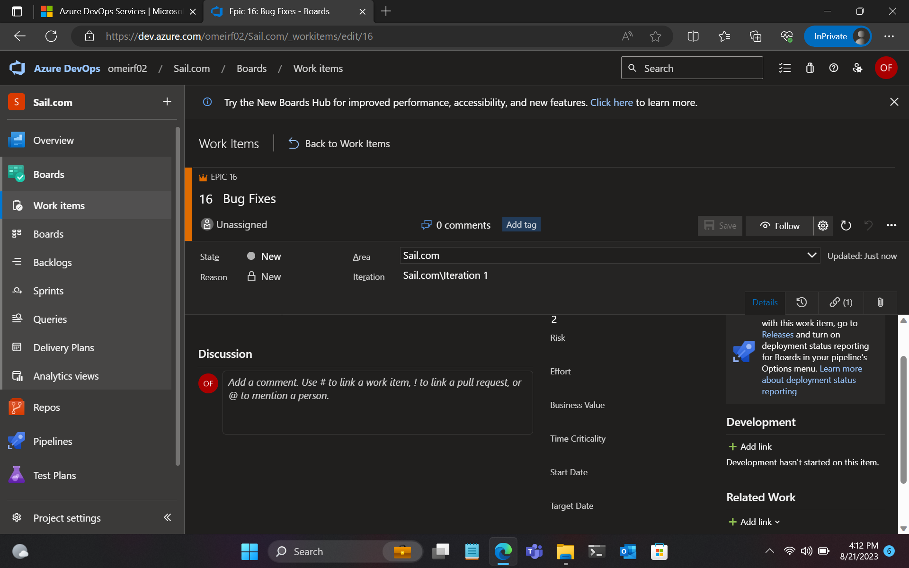
4. Creating an Epic in Azure DevOps

Slide 9
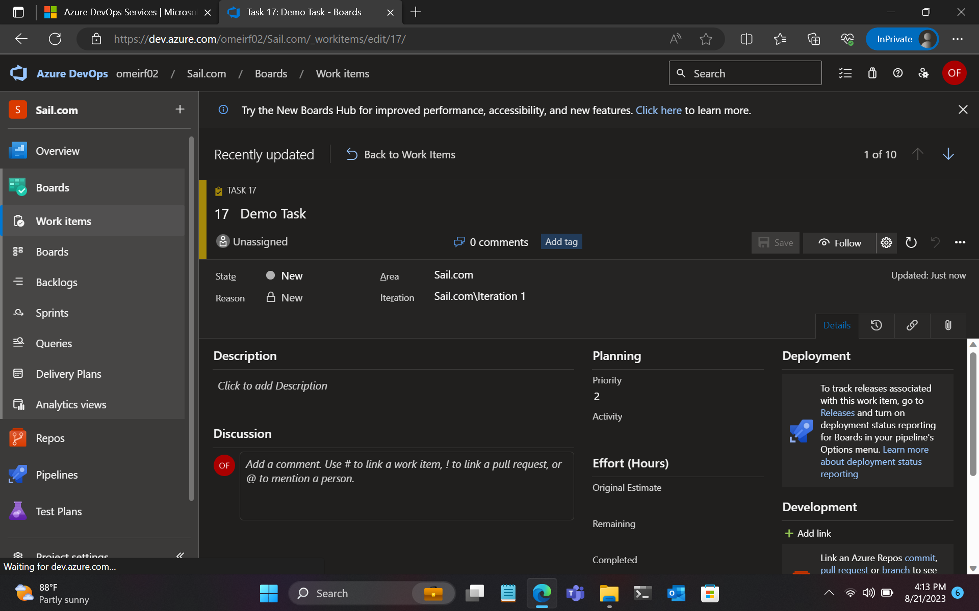
5. Creating a Task in Azure DevOps

Slide 10
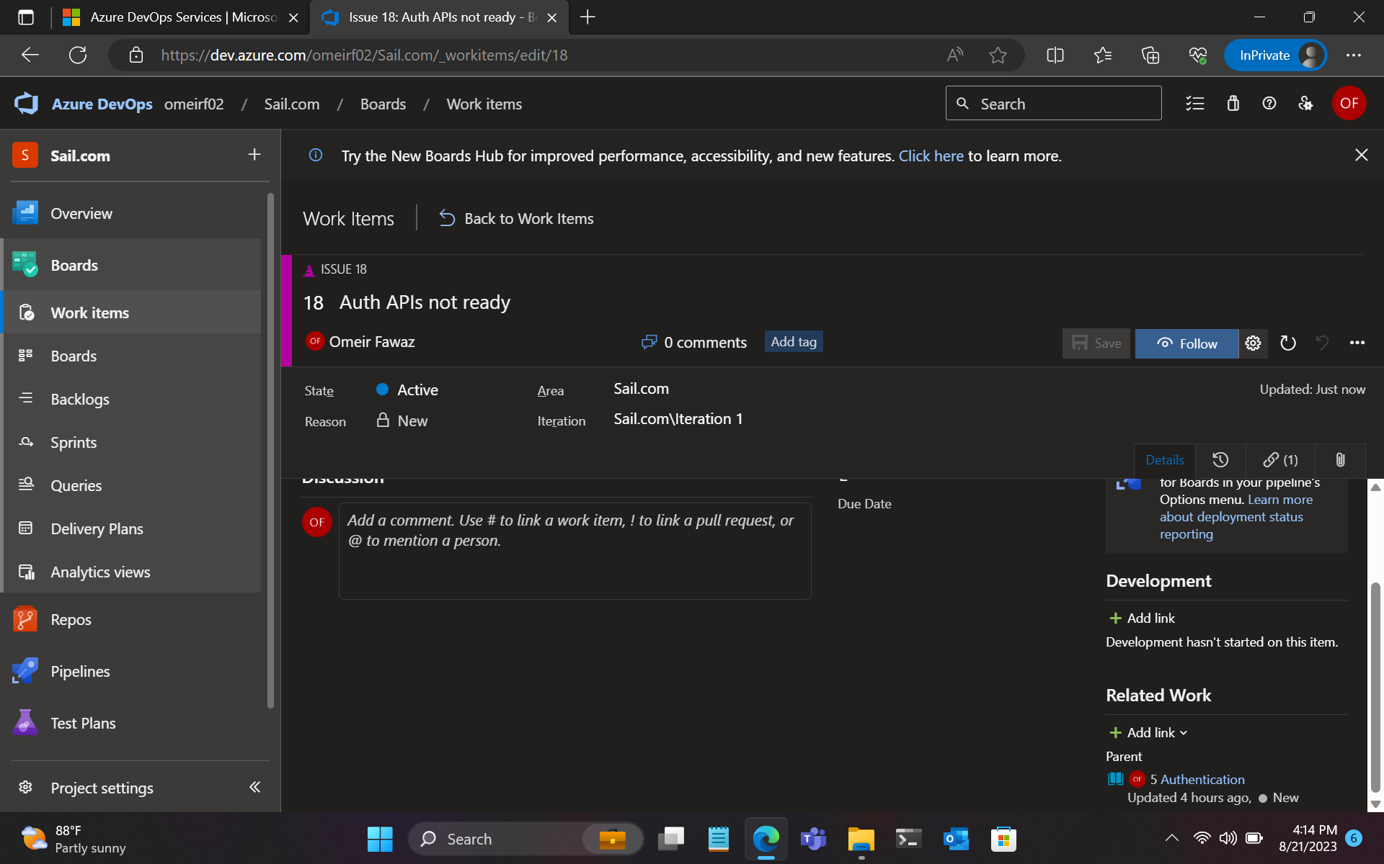
6. Creating an Issue in Azure DevOps

Slide 11
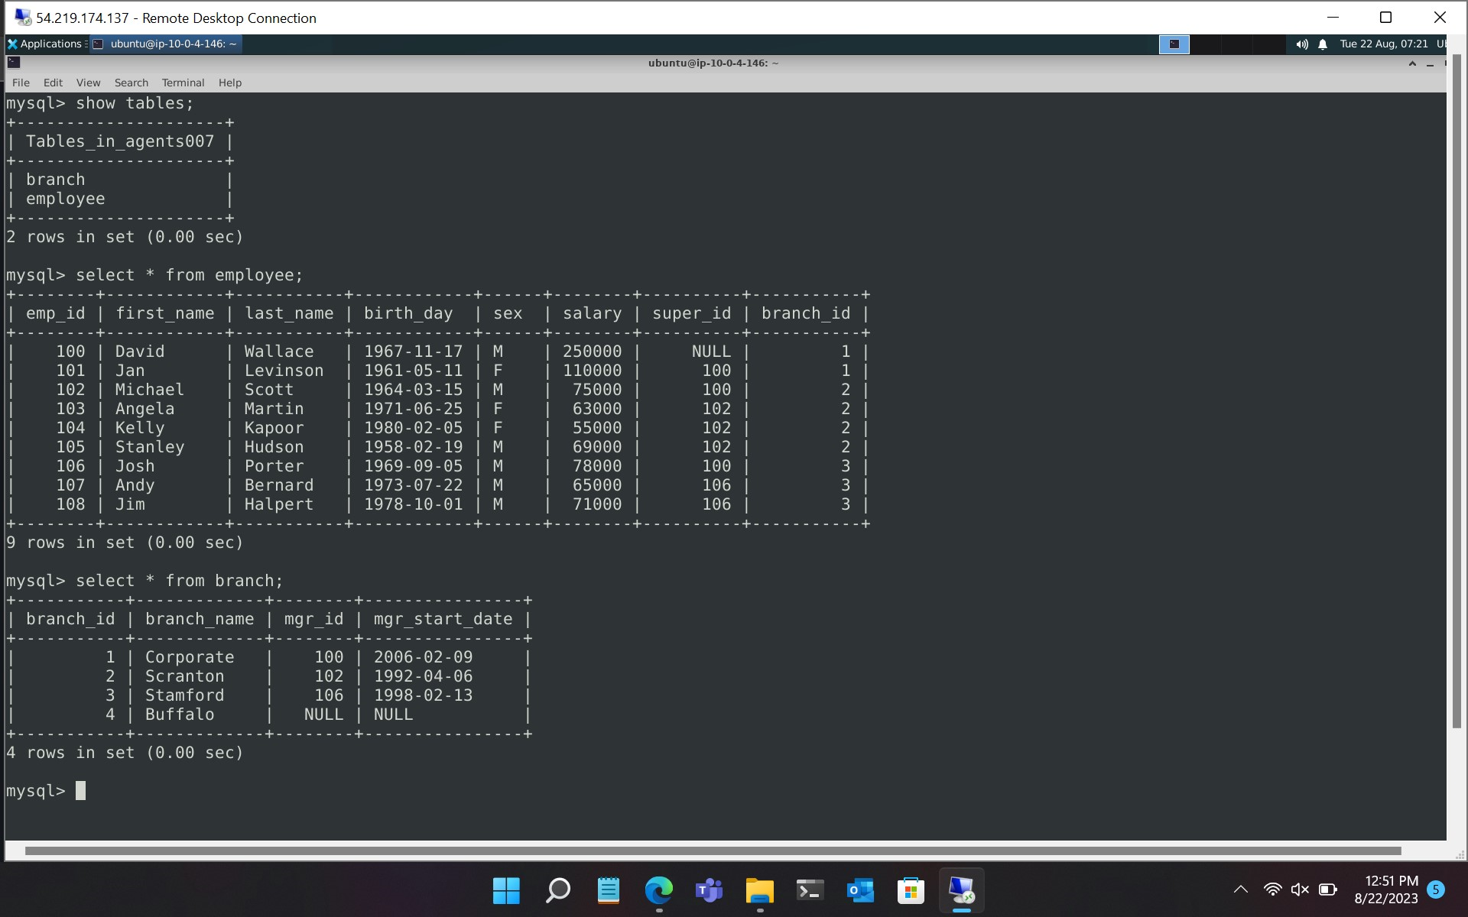
2.2 DBMS
Learnt about the following:
Advantages of DBMS
Types of Databases
Types of SQL Commands
DDL
DML
DQL
DCL
TCL

Slide 12
2.3 Testing
Learnt about the following:
Need for testing software
Types of testing
Testing tools (Selenium)
Monitoring tools (Nagios)

Slide 13
2.4 DevOps – CI/CD
Learnt about the following:
Planning tools: JIRA
CI tools: Jenkins, GitHub Actions
CD tools
Container and orchestration (Docker, Kubernetes)

Slide 14
2.5
Azure VM and GitHub Actions

Slide 15
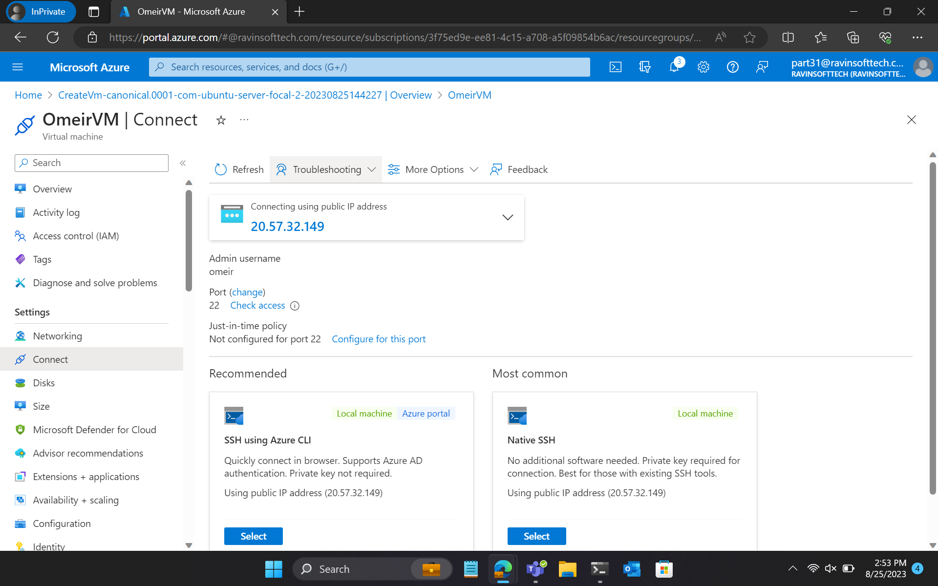
1. Creating a Linux VM in Azure Portal

Slide 16
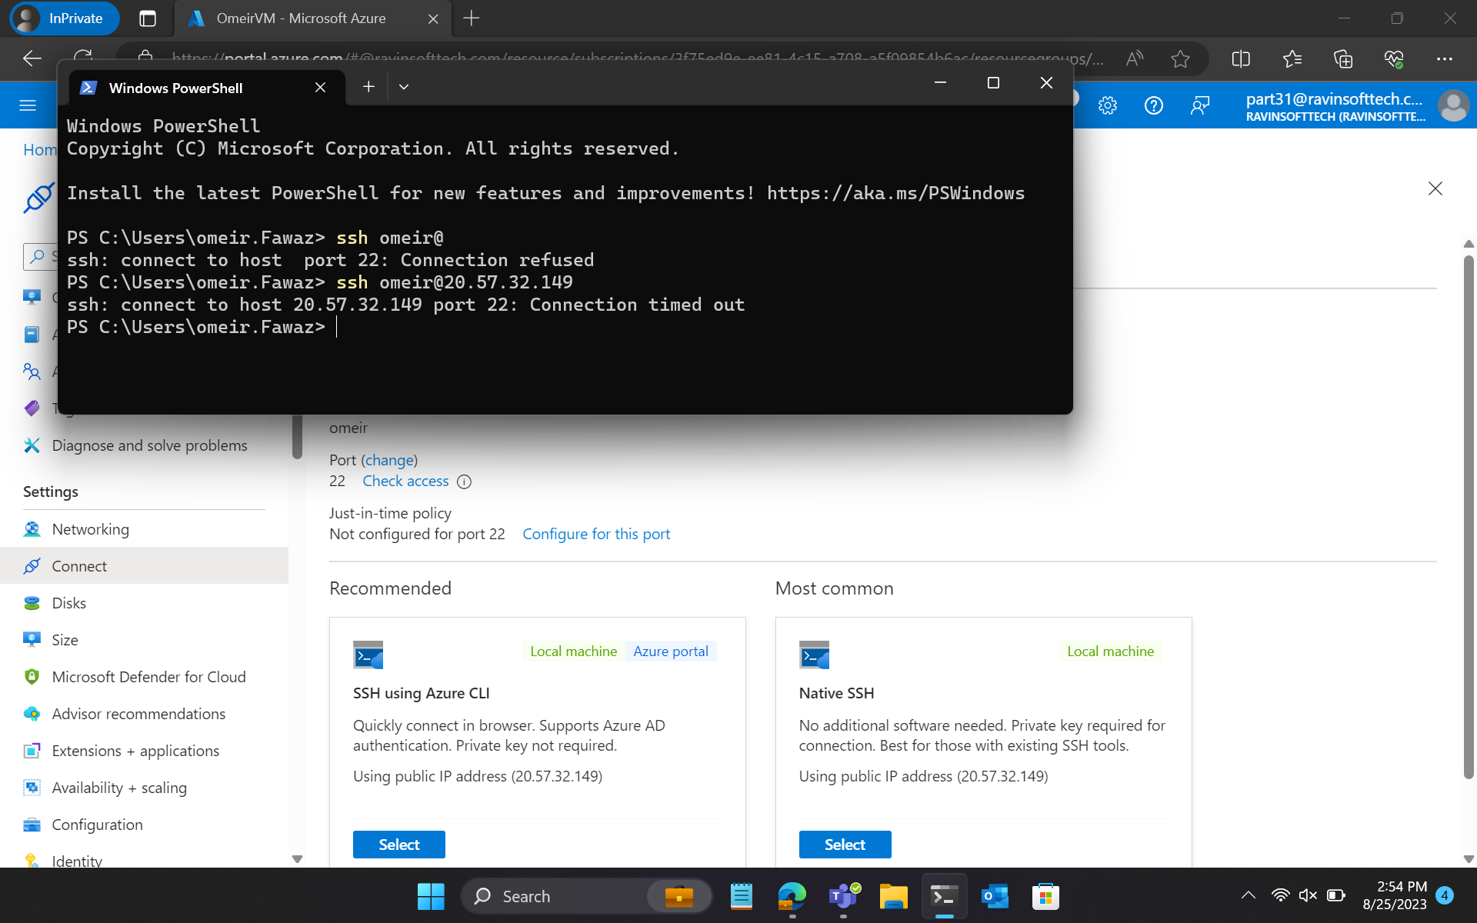

Slide 17
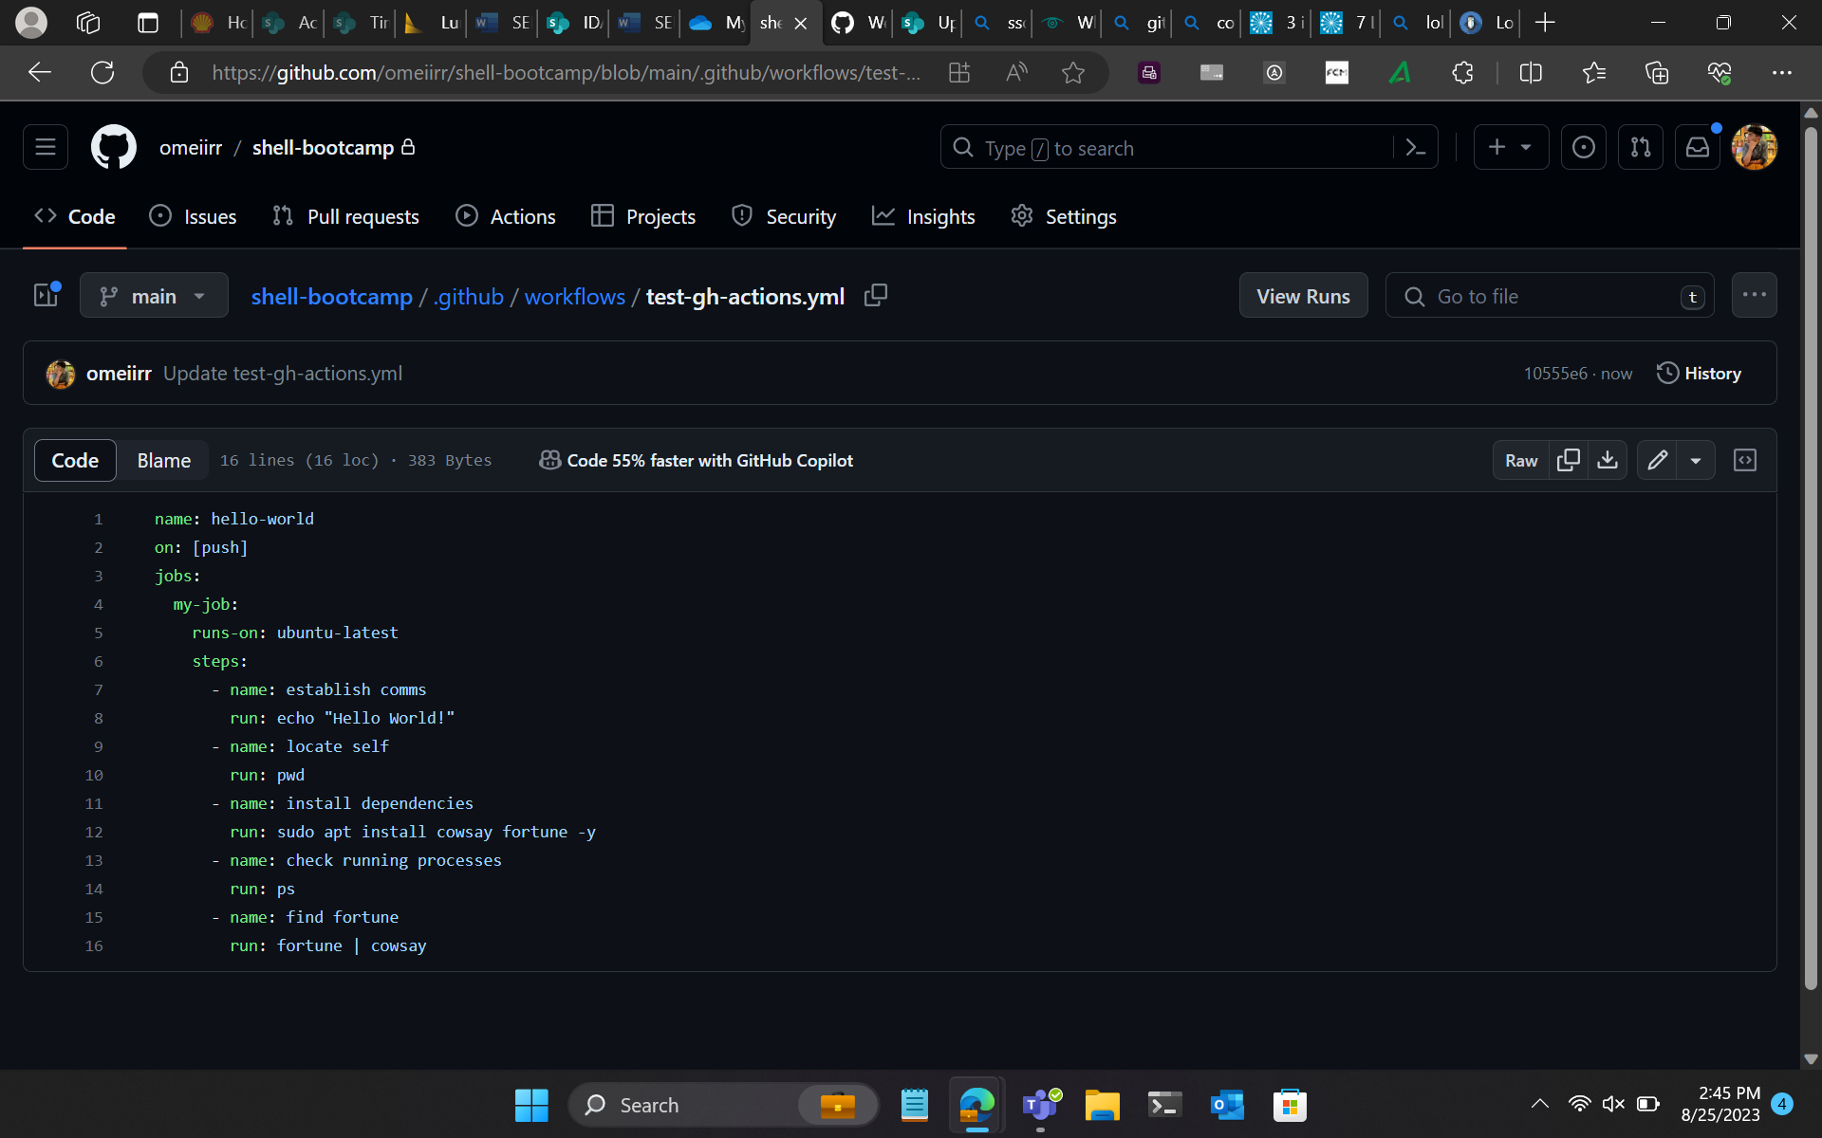
2. Setting up GitHub Actions

Slide 18
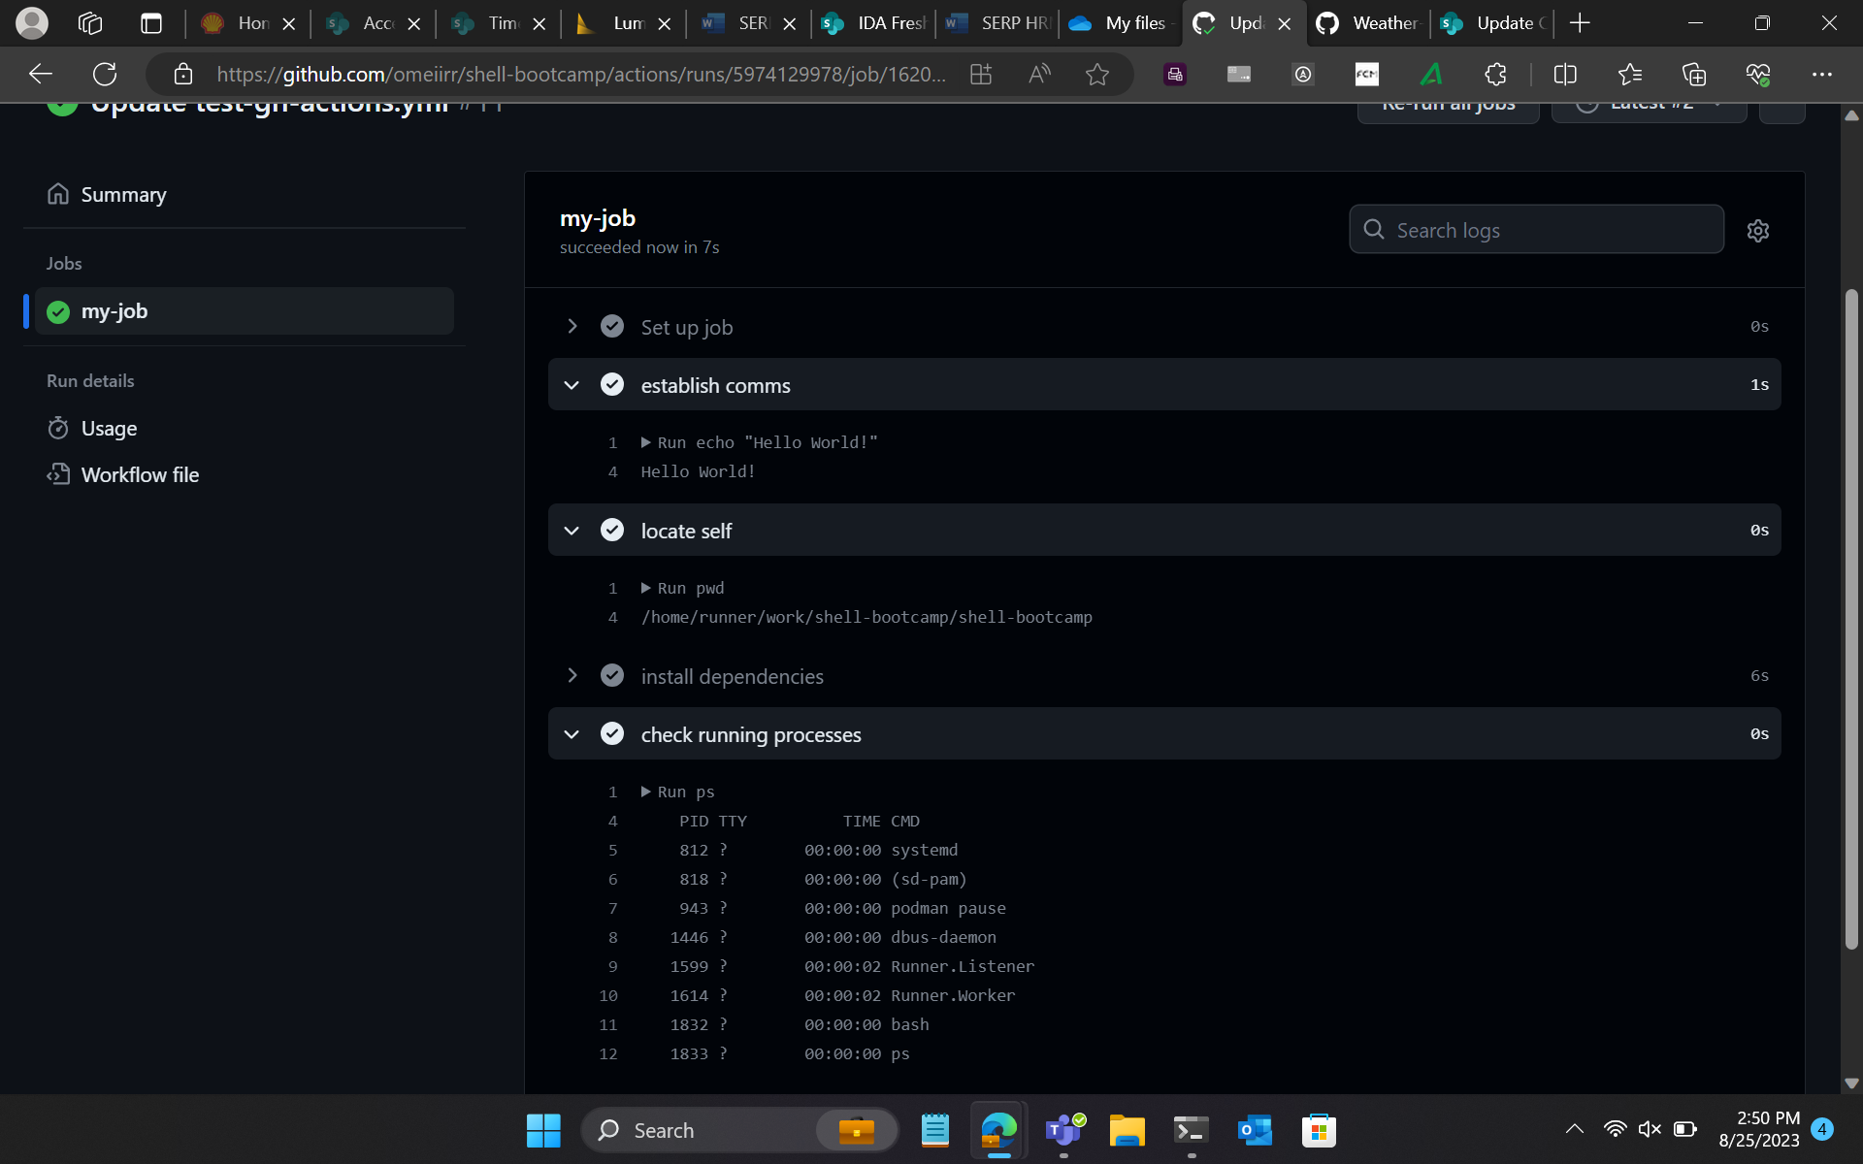

Slide 19
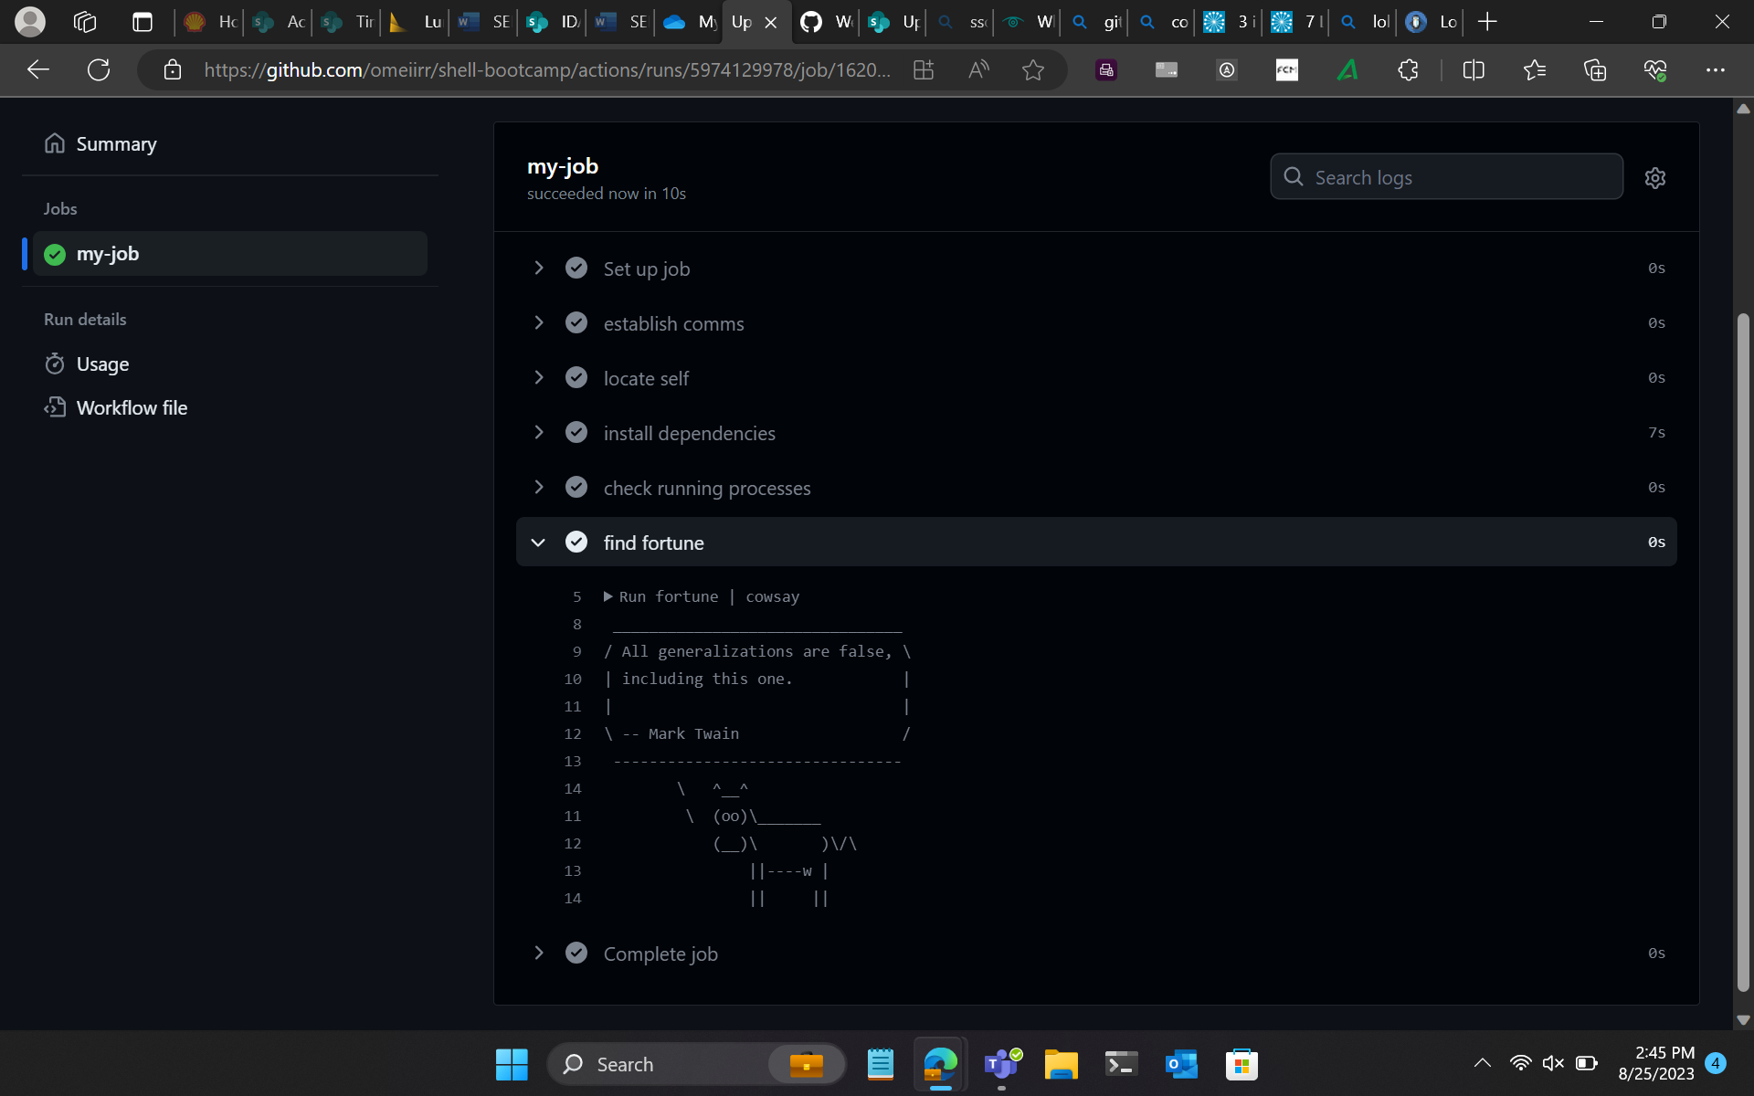

Slide 20
